Slide 1

“Girl” by Jamaica Kincaid

Slide 2

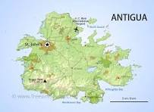
Kincaid, Her Mother, Antigua
I come from the small island of Antigua and I always wanted to write; I just didn’t know it was possible.”
“I’ve written a book about my mother, and I don’t remember anyone going to Antigua or calling up my mother and verifying her life. There is something about this book that drives people mad with the autobiographical question.”
“Like father like son, like mother like daughter!”

Slide 3
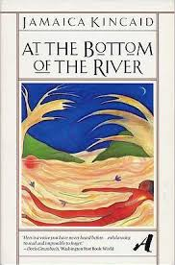
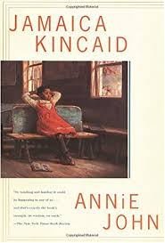
“Girl”: Prose or Poetry—Hear Kincaid Read
First Printing in The New Yorker
Collected as first story in At the Bottom of the River
The “Girl” may wind up as title character in second collection, Annie John

Slide 4
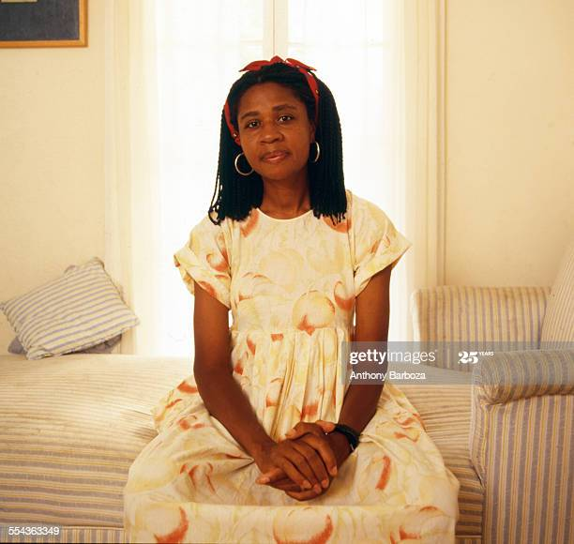
Brief Commentary on Jamaica Kincaid
When I spoke with Kincaid a number of years ago, she spoke very favorably about her mother, remembering that …. Her father was a carpenter and what she remembers most vividly about him was that he always had a carpenter’s pencil behind his ear. Her memories of him were also loving. But as she says in the quotation here: Like father, like son; …. She has written much about her mother, and many of her thoughts about her mother are contained in An Autobiography of My Mother. When we first read “Girl,” we likely conclude that the words of the mother to the daughter are likely similar to one’s Kincaid’s mother perhaps said to her Kincaid as she was growing up. Does the final quotation here suggests that readers have or have not sought to verify the accuracy about things she has written about her—or perhaps in a broader sense that readers should or should not try to discover the factual accuracy of what a writer writes—whether it is labelled as fact or as fiction.

