Slide 1
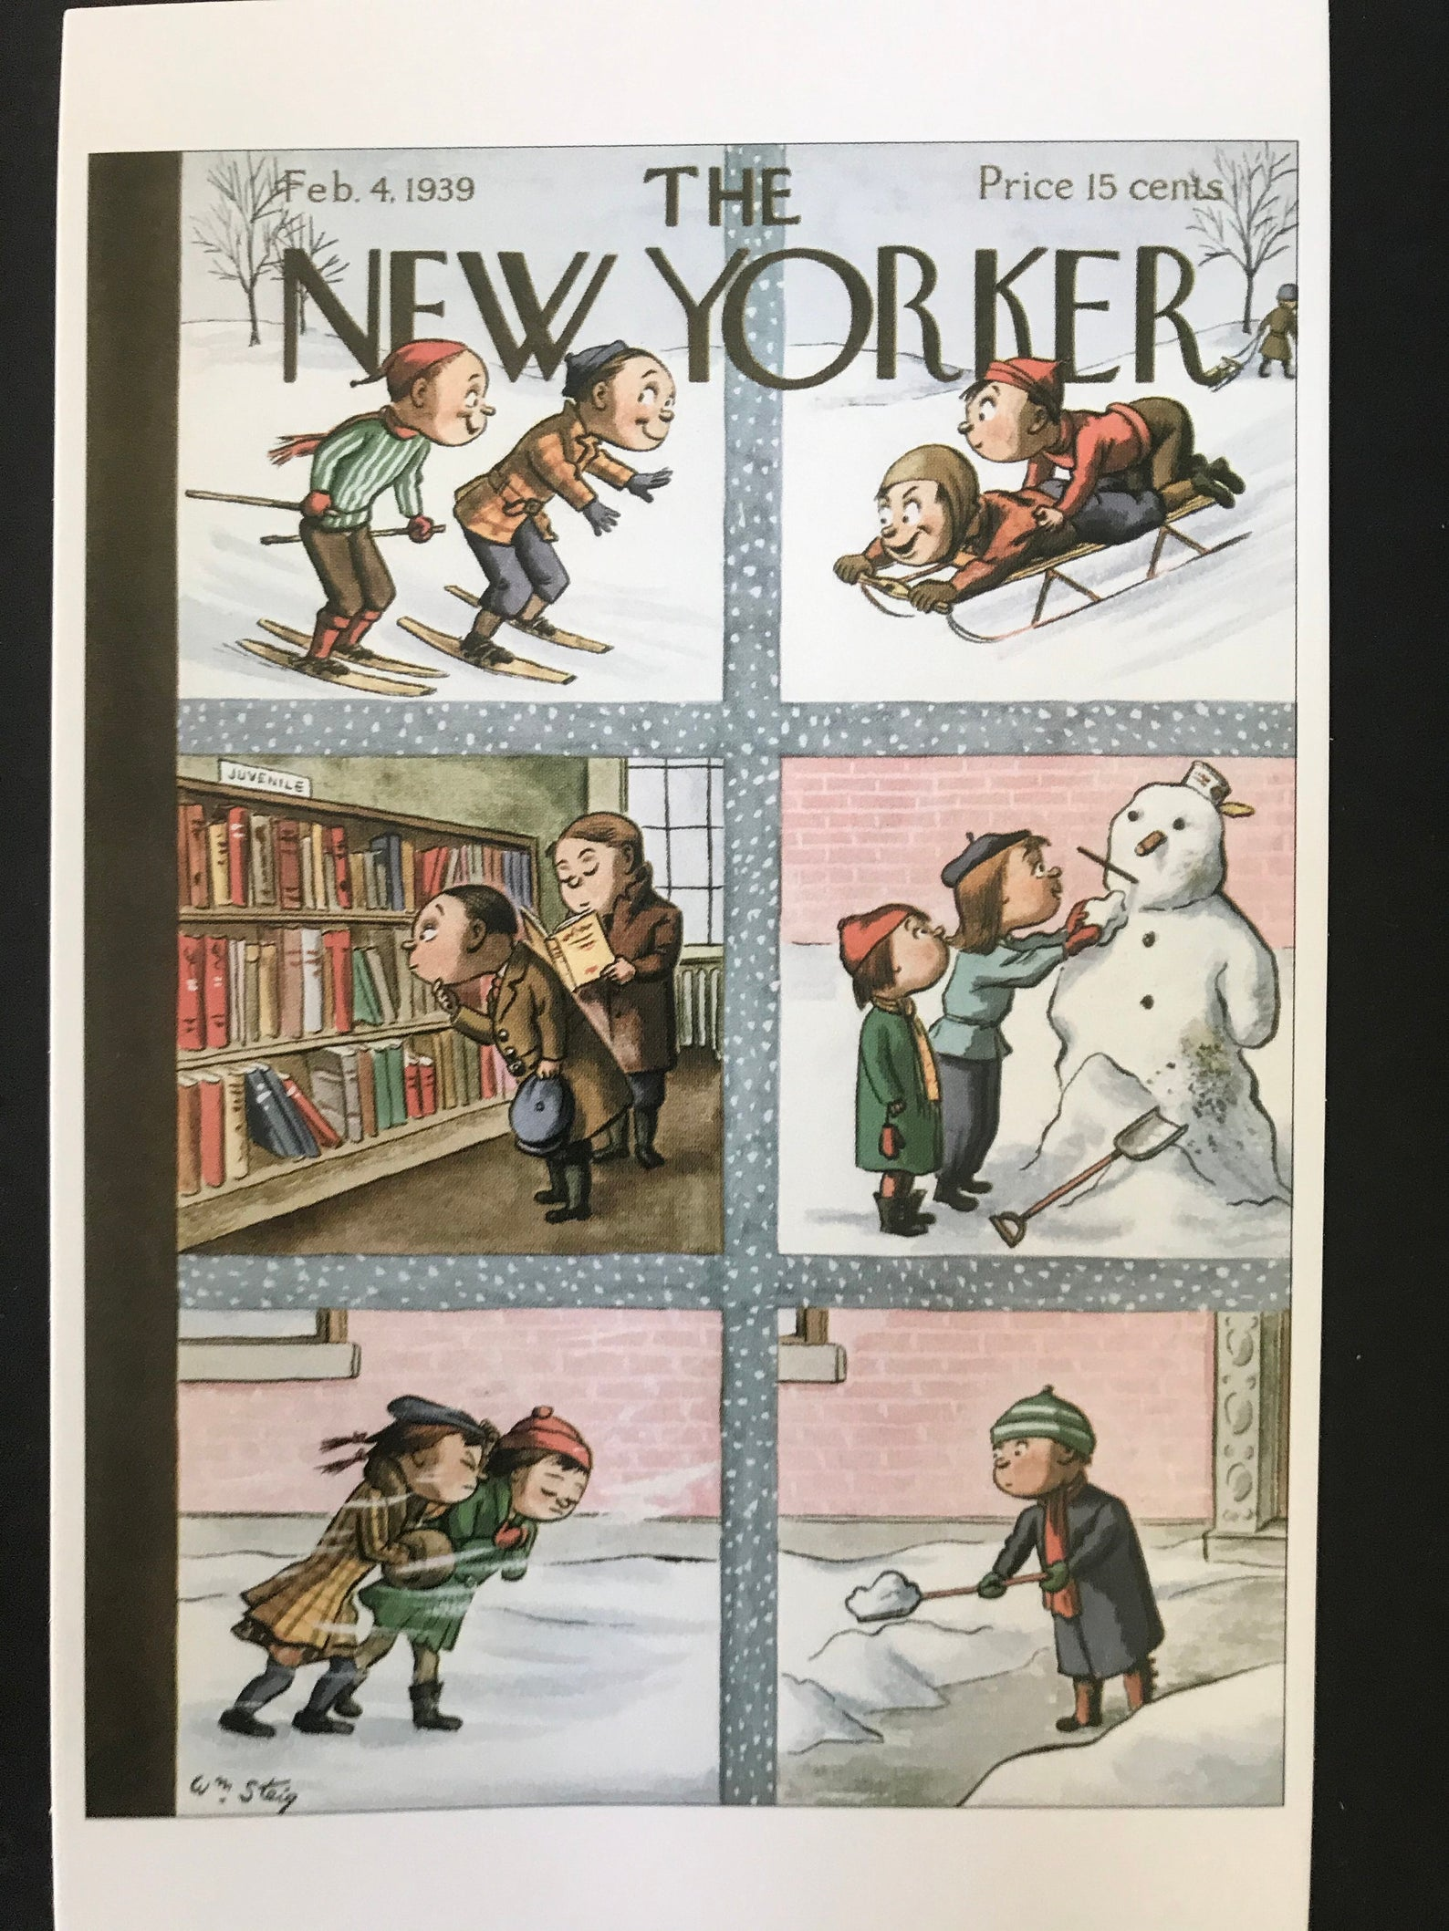
“The Girls in Their Summer Dresses”
Two Versions: The New Yorker Maxwell-edited version and Shaw’s Original Version

Slide 2

Shaw’s Story of the Composition
Shaw maintained he “tapped it out” in a seedy New York hotel, left it face down on a table, went out for a drink, came back to find his fiancé had read it and was furious. He knew he had something good because of her reaction. He sent it to The New Yorker.
This version is recounted
In the biography above

Slide 3
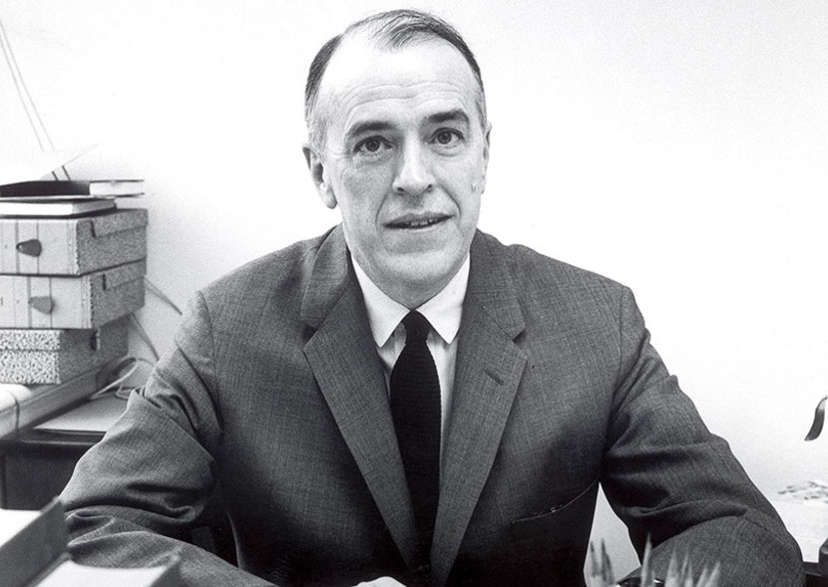
William Maxwell’s Editing of Story
William Maxwell, fiction editor for The New Yorker, loved the story, but it was too long for The New Yorker, so in Maxwell’s words, “I cut it about in half.” The Maxwell version was published in the 4 February 1939 issue of the magazine.

Slide 4
First Parts of Shaw’s Original Version
Version 1 (Shaw Version): Transcription of Giants Football Version from Short Stories: Five Decades (1978)
The Girls in Their
Summer Dresses
Fifth Avenue was shining in the sun when they left the Brevoort and started walking toward Washington Square. The sun was warm, even though it was November and everything looked like Sunday morning--the buses, and the well-dressed people walking slowly in couples and the quiet buildings with the windows closed.
Michael held Frances’ arm tightly as they walked downtown in the sunlight. They walked lightly, almost smiling, because they had slept late and had a good breakfast and it was Sunday. Michael unbuttoned his coat and let it flap around him in the mild wind. They walked, without saying anything, among the young and pleasant-looking people who somehow seem to make up most of the population of that section of New York City.
“Look out,” Frances said, as they crossed Eighth Street. “You’ll break your neck.”
Michael laughed and Frances laughed with him.
“She’s not so pretty, anyway,” Frances said. “Anyway, not pretty enough to take a chance breaking your neck looking at her?”
Michael laughed again. He laughed louder this time, but not as solidly. “She wasn’t a bad-looking girl. She had a nice complexion. Country-girl complexion. How did you know I was looking at her?”
Frances cocked her head to one side and smiled at her husband under the tip-tilted brim of her hat. “Mike, darling . . . ” she said.
Michael laughed, just a little laugh this time. “O.K,” he said. “The evidence is in. Excuse me. It was the complexion. It’s not the sort of complexion you see much in New York. Excuse me.”

Slide 5
First Part of Maxwell-Edited Version
Version 2 (New Yorker Version): Transcription of Metropolitan Museum of Art Version from The New Yorker (Feb. 4, 1939)
THE GIRLS IN THEIR SUMMER DRESSES
FIFTH AVENUE was shining in the sun when they left the Brevoort. The sun was warm, even though it was February, and everything looked like Sunday morning—the buses and the well-dressed people walking slowly in couples and the quiet buildings with the windows closed.
Michael held Frances’ arm tightly as they walked toward Washington Square in the sunlight. They walked lightly, almost smiling, because they had slept late and had a good breakfast and it was Sunday. Michael unbuttoned his coat and let it flap around him in the mild wind.

Slide 6
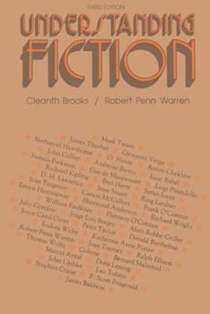
Debate in Progress:
Which Version Is the Best
Cleanth Brooks and Robert Penn Warren reprinted the Maxwell-Edited New Yorker version in their influential Understanding Fiction as “a very good example of the compact , well-made short story.” Shaw never commented on the fact there were two versions of the story and reprinted his original version in every collection of his stories until his death.
To read the versions side by side go to bryantmangum.net. Click on English 301 and scroll down to “Both Versions.”

